Slide 1
Leadership, Management
&
Team Building
Skills you need to know and practice

Slide 2
Core Competencies
Leadership, management and building effective teams are critical roles (Core Competencies) for (neuro)scientists and principal investigators now and in the future.
According to the National Postdoctoral Association in addition to becoming a subject matter expert and achieving independence during a postdoctoral fellowship, six additional core competencies, including “Leadership and Management Skills”, should be gained during this period.
The aim of this short presentation is to expose participants to effective leadership and management styles, as well as what makes high performing teams
www.nationalposdoc.org/?corecompetencies

Slide 3
Content
Leadership
Management
Team building

Slide 4
Content
Leadership
Management
Team Building

Slide 5
The Leadership Drought
Leadership development is the #1 priority for organizations in the world. The challenge is urgent and growing in importance
- 89% of executives rated the need to strengthen, re-engineer, and improve organizational leadership as an important priority.
- The profile for top leaders is complex and evolving
      Leaders of top scientific efforts (PIs) today and in the future require understanding
        how to lead global collaborations with labs around the world
        how to conceptualize new and faster solutions to scientific problems by leading public-private partnerships (including academic labs, for-profit interests, governments and other stake-holders) to achieve their own unique goals
        how to discern and integrate new areas of knowledge and scientific progress into existing programs/collaborations to ensure optimal outcomes
        what skills are needed to develop and train the next generation of diverse scientists and researchers
Global Human Capital Trends 2016
The new organization: Different by design,
Deloitte University Press

Slide 6
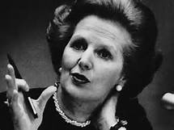
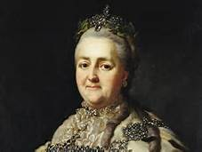
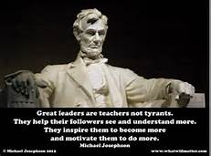
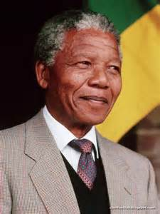
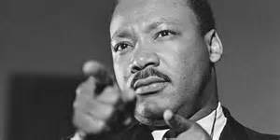

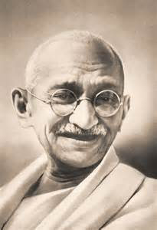
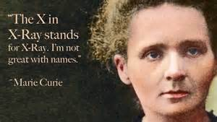

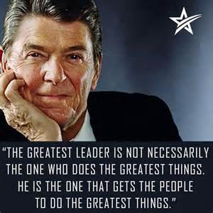
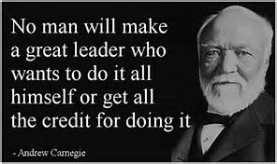
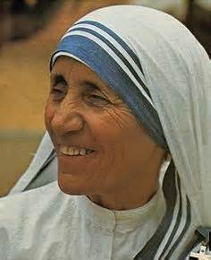
Leadership
Definition
  “If your actions inspire others to dream more, learn more, do more and become more, you are a leader” John Quincy Adams
Notes:
There are as many definitions of leadership as there leaders, but this one by John Quincy Adams incorporates many of the aspects of most definitions of leadership exemplified by all the well-known figures represented on this slide. One image which may not be recognized to the top right of center is Catherine the Great, who rose to power after her husband, Peter III, was assassinated. Under her rule, Russia grew and emerged larger and stronger and became one of the great powers of Europe in the 18th century. Leadership is more about leading people than it is about leading projects.

Slide 7
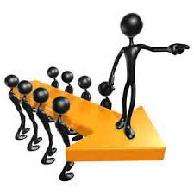
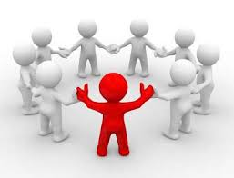
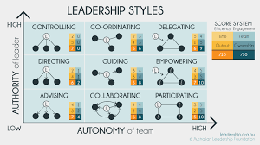
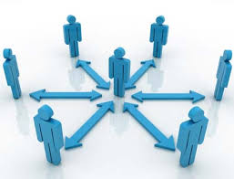
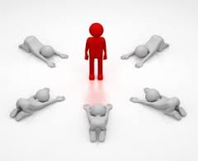

Leadership styles
Notes:
Depending on who you read, up to 12 different styles of leadership have been identified from ‘autocratic’ type leadership illustrated at bottom left, to ‘follow the leader’ at bottom center, ‘coaching’ style leadership represented at bottom right, ‘democratic’ leadership at top right and ‘visionary’ leadership at top left where leaders recognize that their vision can only be realized through people.
The balance between the level of authority of the leader and the automony of the team, indicates various styles of leadership which are depicted by the Australian Leadership Foundation in the center of the slide.

Slide 8
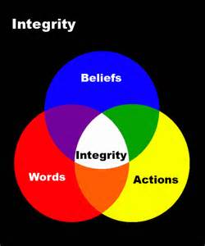

Leadership
Basic leadership skills (1/2)
Integrity
  Principled
  Honest
  Treats others as they wish to be treated
  Passionate about beliefs
  Perseveres when the going gets tough
  Alignment between actions and words
Vision
  Sees the future of where things need to be and
    attracts commitment and energizes people
    creates meaning in the lives of followers
    establishes a standard of excellence
    bridges the present to the future
    transcends the status quo.
  Communicates effectively to paint the picture and inspire others towards the future state that you perceive
Notes:
Integrity is frequently identified as the key criterion and top leadership skill without which leaders cannot achieve success. The lack of integrity by national and international leaders has played out in the world media across all sectors, seemingly without exception. Society expects that its leaders will be principled, honest, walk the talk and hold themselves accountable. These important aspects, when exhibited by a leader, results in the perception of a person of integrity. [Go through the sub-bullets]
Vision is one of the differentiating factors that separates out leaders from everyone else. Having a vision of the future is imperative, but equally important for success is the leader’s capacity to translate their vision into reality by working with and through their team by making real each of these aspects identified. [Go through the sub-bullets]

Slide 9
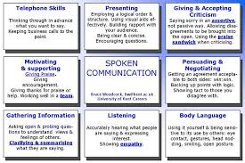
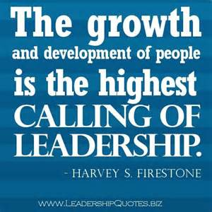
Leadership
Basic leadership skills (2/2)
3. Communication
  Consummate leaders need to know
    how to share as well as how to seek information
    what to communicate to whom and when
    how to choose the appropriate medium of communication is
    how to communicate with large and small audiences
    when not to communicate.
  Do you listen more than you speak?
  Do you communicate with your person as well as with words?
  How do you handle confidential information or bad news?
4. Developing People
  Encouraging, helping, coaching and/or mentoring people to stretch and grow their capabilities beyond their current status. People follow you because of what you do for them.
    Do you exude and instill trust and respect in those around you?
    Do you have superior networking, interpersonal and group communication skills?
Notes:
Charismatic leaders are typically those who are able to inspire and encourage people almost to the point of devotion to a certain cause. These leaders have extraordinary communication skills which are multifaceted and illustrated here by Bruce Woodcock of the University of Kent, UK. It includes verbal and non-verbal skills including [read bullets]. When you communicate, [read the questions]
Handling confidential information or bad news is typically at the forefront of developing people. Harvey Firestone referred to this as the “highest calling of leadership.” Developing people can take various forms and/or all forms at different times and under different circumstances. Encouraging, helping, coaching and mentoring people to help them stretch and grow their capabilities beyond their current status will endear them towards a leader and they will follow you not only for who you are, but because of what you do … for them.

Slide 10
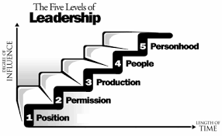
The Ultimate Leader
The best leaders are also good managers, although it is rare to find the best traits of both in one person
“Everything rises and falls on leadership”
John C. Maxwell
Notes:
John Maxwell belongs to the school of leadership gurus who support the position that leadership is a skill that can be taught, rather than people can only be born as leaders. His five levels of leadership promote that one’s skill as a leader grows with increasing influence over time. The first level he refers to as ‘Position’.
‘Position’ leadership: At this level, people follow you because you have the title or “rank”. Because you are the boss they will do as you say, but they will do the bare minimum. They will not go the extra mile for you.
At ‘Permission’ leadership level, people want to follow you because they trust you. This level of leadership is based on “relationship”.
At the level of ‘Production’, people follow you because you achieve “results”. Accomplishments are clear at this stage and people want to be associated with success.
‘People’ leadership is Firestone’s “highest calling of leadership”. People follow you because of what’s in it for them! You poor your life into developing them. You “reproduce” leaders. At this level you achieve much for people as well as organizations.
The top level of ‘Personhood’ has also been named ‘Pinnacle’ leadership. People follow you because of who you are … your values and what you represent and they “respect” you. Few leaders are at this level of influence and it is not easy to get here according to Maxwell. It takes considerable time and consistent effort in the small and big decisions in life. This is where you want to be; strive for this level of leadership.

Slide 11
Leadership
Skills gained at graduate school/postdoc fellowship
  Facilitate group discussions or conduct meetings
  Respond appropriately to positive or negative feedback
  Collaborate on projects
  Effectively mentor subordinates and/or peers
  Teach skills or concepts to others
  Motivate others to complete projects
  Navigate complex bureaucratic environments
  Vision to see what is needed to advance a scientific area
https://careercenter.umich.edu/article/phd-transferable-skills
Notes:
If you have been through graduate school and certainly during your postdoctoral training, you would have had the opportunity to engage in many forms of leadership activities. [Read through bullets]. Use these as a start to assess where you are as a leader which we will come back to later on in the presentation.

Slide 12
Leadership
Key take-away messages
  Some leadership skills are learned during graduate school and postdoctoral fellowships, but many require additional and targeted training. Leadership can be taught.
  Leaders of (neuro)science in the future need to be more than subject matter experts. They need to be able to lead people in complex collaborations such as public-private partnerships.
  There are various leadership styles, but the best leaders exhibit integrity & vision, are consummate communicators and focus on developing people over projects.

Slide 13
Content
Leadership
Management
Team Building

Slide 14
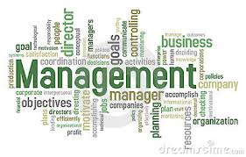
Management
Definition
  Management can be simply defined as the organization of processes and people to achieve a desired result
  “Good management is the art of making problems so interesting, and their solutions so constructive,
  that everyone wants to get to work and deal with them.”
  Paul Hawken
Notes:
[Read the bullet and the quote on the slide]

Slide 15
Six Management Styles
Based on Daniel Goleman’s classic study (Harvard Business Review, 2000) of more than 3000 mid-level managers
  Directive - The “do it the way I tell you” manager
  Authoritative - The “firm but fair” manager
  Affiliative - The “people first, task second” manager
  Participative - The “everyone has input” manager
  Pacesetting - The “do it myself” manager
  Coaching - The “developmental” manager
6 Management Styles and When Best To Use Them –
The Leaders13 Tool Kit, The Huffington Post, April 16, 2013
Rosalind Cardinal
Notes:
In 2000, Daniel Goleman published his 3-year study of more than 3000 mid-level executive managers about their management styles, their impact on the corporate world including profitability. The research showed that management style accounted for 30% of the company’s bottom line! These are the 6 management styles he uncovered as communicated by Rosalind Cardinal in an article published in the Huffington Post in 2013 and updated in 2015. [Review the bullets and add the following applications for each bullet]
Directive management – Effective when there is a crisis and when deviations are risky. Avoid when employees are underdeveloped or highly skilled as they become frustrated and resentful at the micromanaging.
Authoritative management – Is effective when clear directions and standards are needed and the manager is credible. Avoid it when employees need guidance on what to do and/or the leader is not credible as the people won’t follow your vision if they don’t believe in it
Affiliative management – Is effective when tasks are routine, performance adequate, when counseling, helping, or managing conflict. Avoid it when performance is inadequate as affiliation does not emphasise performance or if there is a crisis situation that requires direction
Participative management – Is effective when employees are working together and have experience and credibility. Avoid it when employees must be coordinated or there is a crisis and no time for meetings or if there is a lack of competency & close supervision is required
Pacesetting management – Is effective when people are highly motivated, competent and require little direction e.g., with experts. Avoid it when workload requires assistance from others or when development, coaching & coordination required
Coaching management is effective when skills needs to be developed and employees are motivated and wanting development. Avoid it when the manager lacks expertise or the performance discrepancy is too great or there is a crisis. Coaching managers may help rather than release a poor performer.

Slide 16

Management
Characteristics of great managers
  Stellar managers create superior dynamics where teams:
    achieve great results because team members trust one another
    work seamlessly with one another
    are excellent at making decisions
    hold one another accountable for making things happen

Slide 17
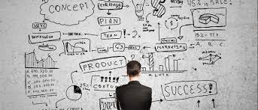
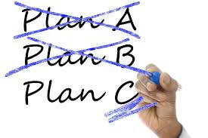
Management
Basic management skills (1/2)
Plan
  What is the “SMART” goal?
    Specific – Clear and detailed objectives which is significant if achieved
    Measurable – Can be achieved, quantified and meaningful, even motivational to the team
    Agreed – The team involved needs to agree to it. It needs to be attainable and action-oriented
    Realistic – The goal needs to be relevant, reasonable, rewarding and results-oriented
    Timely – The goal should be tangible and able to be tracked using deadlines
  What is the desired result?
  What is the complexity and what are the options?
  What will it take to achieve success?
Organize
  This is where the rubber hits the road and all the plans in the world are ineffective without organized and synchronized execution
    Are the right people involved and do they understand their roles?
    Are the right tools and processes in place?
    It timing coordinated?
    What happens when the task is accomplished? Is there a hand-off?
Notes:
1. Planning is the most critical skill of managers. Success is difficult at best, and impossible at worst, without planning. As the saying goes, “If you fail to plan, plan to fail.” Plan for the best case scenario, plan for the worst case scenario and plan a couple other options whilst you’re at it. Use SMART goals. [Review the questions then the bullets]
2. Organizing [Review the bullets]

Slide 18
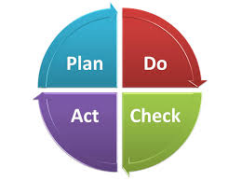
Management
Basic management skills (2/2)
3. Direct
  Once the planning and organization is completed and the project begins, the role of the manager turns to orchestrating flawless execution by and of:
    People
    Systems
    Timing
4. Monitor
  Checking on the project on a regular basis via systematic review of each step is important because issues arise. This is where you are able to determine whether you could operate on your optimal plan to over-deliver or engage alternative options when problems arise.
    Tracking
    Trouble-shooting
    Tweaking
    Motivating
    Encouraging
Notes:
3. Directing [Review the bullets] Directing people can be done in various ways as addressed on the slide on the 6 different management styles. Make sure to use the right approach for the team and circumstances. Managing systems, tools, and processes in today’s world is similar to what we do with various techniques and equipment that are used in academic experimentation and is about optimum efficiency and automation to improve productivity. Today much can also be maximized through the use of network management using telecommunications technologies. Timing can be important to the success or failure of the project, especially if changes are occurring. Make sure to get this right. The right decision or process made, or in place at the wrong time, is a poor decision or process.
4. Monitoring [Review the bullets] Tracking, trouble-shooting, tweaking, motivating and encouraging are all important aspects of managing processes and people. They are needed to ensure that the team delivers results on budget and on time.

Slide 19
Management
Skills gained at graduate school/postdoc fellowship
  Work effectively under pressure with deadlines
  Comprehend new material and subject matter quickly
  Work effectively with limited supervision
  Manage projects from beginning to end
  Identify goals and/or tasks to be accomplished and a realistic timeline for completion
  Prioritize tasks while anticipating potential problems
  Maintain flexibility in the face of changing circumstances
https://careercenter.umich.edu/article/phd-transferable-skills
Notes:
If you were successful in completing graduate school, it would have been in part because of learned management skills. Many of the tasks identified on this slide are familiar to you and your capacity to execute on them may vary, but they are all skills that have brought you to where you are today. [Review the bullets].

Slide 20
Leadership versus Management
Leaders | Managers
Create the vision (What) Transformational Long-term Innovate – breaks rules Inspire people Challenge the status quo Accept failure Heart – Passion – People Seeing & Selling | Execute the vision (How) Transactional Short-term Maintain – make rules Inform people Clarify the status quo Resist failure Head – Control – Processes Doing & Telling
“Management is doing things right; leadership is doing the right things”
Peter F. Drucker
Notes:
Leadership and management are sometimes used interchangeably, but they are in fact different activities as illustrated here. [Review table and summarize with the quote by Drucker]

Slide 21
Management
Key take-away messages
  There are various management styles, but good management requires planning, organization, direction and monitoring.
  During graduate school and postdoctoral fellowships some management skills are attained, but many require mastering such as managing projects through teams
  Leadership and management are two different skill-sets and it is rare to find someone who exemplifies top traits of both.

Slide 22
Content
Leadership
Management
Team Building

Slide 23
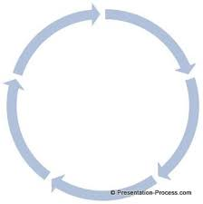
Team Building
Stages
  Forming
    Defining the team, charter, roles, tasks, strategy
    Developing trust and communication
  Storming
    Working through the challenges related to the tasks, processes and persons
  Norming
    Acknowledgment of the team strengths and weaknesses
    Acceptance of members
    Harmonize working
  Performing
    Harmonized working and achieving results together
"Developmental sequence in small groups".
Psychological Bulletin. (1965) 63 (6): 384–399.
Bruce W. Tuckman
Notes:
Bruce Tuckman’s classic stages of how teams develop was published in 1965. If you have been part of a team you probably recognize these stages from your own experience.
In Stage 1 - FORMING The teams asks “Why are we here? “ Whilst the team is being defined, people assess each other. There can be feelings of anxiety & confusion and sometimes little work is actually accomplished. Conflicts can emerge, and leadership, value, strategy & feasibility of task(s) can be challenged. Team members typically feel included & expect that their opinions will be valued & respected as trust and communication is established. At this early stage, the team should be establishing its team charter, strategy, roles, tasks and goals. These need to be defined to be an effective team which will learn how to work together.
In Stage 2 – STORMING, the team asks, “Can we work together? “ More conflicts emerge as members work through the challenges related to the work at hand. Power plays may occur, i.e., who’s in charge & what actions need to be taken toward goals. Instability & polarization could bring conflict out in open. At this stage it is important to encourage transparent and fair communication & affirm that disagreement is healthy & resolvable.
In Stage 3- NORMING, the team asks, “How will we work together? . Rules get created and team members learn to work together productively. Team pride develops and norms are established for how people treat each other, meetings are conducted, who will do what work & how it the goals will be achieved based on the strengths and weaknesses of the team. Team member accept each other and working becomes harmonized. Skills & understanding are deepened and productivity is increased. The environment has become safe to share opinions & skills which are evaluated critically & constructively.
In the final Stage 4 – PERFORMING – The team asks, “How can we work smarter? “ The team becomes fully engaged and functional. It is harmonized and achieves results by working seamlessly together as they diagnose, solve problems & make decisions. This is the highest stage of creativity and productivity and the team can handle new tasks working together or delegating work. Team members share leadership, responsibility and accountability.
Typically, the process is linear as the team goes from one stage to the next, however, as new challenges arise the team can move in an out of stages 2 (STORMING) to 4 (PERFORMING) more easily because of the trust that has been built over time. Teams that achieve this level are high-performing teams.

Slide 24
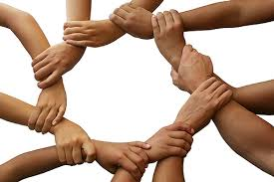
High-Performing Teams
Definition
  “A team is a small number of people with complementary skills who are committed to a common purpose, set of performance goals, and approach for which they hold themselves mutually accountable.”
  The Discipline of Teams, Jon R. Katsenbach and Douglas K. Smith (Harvard Business Review, July-August, 2005)
  Team effectiveness can be influenced by the personality types and traits of its individual members. Personality “types” are sometimes thought to involve qualitative, whereas personality “traits” maybe classified as quantitative differences between individuals. There are several models of assessment for both indices, e.g., MBTI, Five-Factor Model
  A high-performing team (HPT) is committed, coordinated, focused, adaptable and has diverse skills and talents
    communicates optimally
    aligns itself around key initiatives
    creates short-term/long-term plans
    takes ownership of key accountabilities
    holds itself accountable to deliver the required results
  “None of us are as smart as all of us”
  The New Science of Building Great Teams, Alex “Sandy” Pentland (Harvard Business Review, April, 2012)
Notes:
[Review bullets on slide]

Slide 25
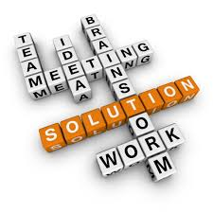
High-Performing Teams
Group Dynamics
  “The best teams invest a tremendous amount of time and effort exploring, shaping and agreeing on a purpose that belongs to them both collectively and individually. This ‘purposing’ activity continues throughout the life of the team.”
  The Discipline of Teams, Jon R. Katsenbach and Douglas K. Smith (Harvard Business Review, July-August, 2005)
  Group dynamics of HPTs centers on how teams communicate and operate:-
    - Energy
      How team members contribute to the team
        Everyone on the team talks and listens in roughly equal measure
        Keep contributions “short and sweet”
        Take ownership
    - Engagement
      How team members communicate with one another
        Connect directly with one another, not just the team leader
        Side-conversations within the team
    - Exploration
      How team members educate each other
        Seek fresh perspectives from other groups
        Bring information back to the team
Notes:
[Review bullets on slide]

Slide 26
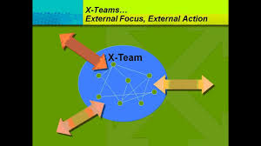
X-Teams
Innovative teams
Teams can be insular and this can be self-limiting. The concept of “X-teams” brings excellence to teams by seeking expertise and input external to the team. Advances in the area of scientific endeavor can come from seeking knowledge and experience external to the lab, PI or even the field of acknowledged experts
Principles
  High level of external activity
  Combined with extreme execution
  Incorporate flexible phases
Structure
  Extensive ties to others outside of the team
  Expandable tiers
  Exchangeable membership
  “If the need for innovation, flexibility and coordination is not clear,
  then a traditional team may be a better solution.”
  “X-Teams”, Deborah Ancona, Henrik Bressman,
  Harvard Business School Press, 2007
Notes:
In 2007, Ancona and Bressman published their book, “X-Teams” where they make a case to help teams achieve excellence by seeking expertise and input external to the team. The theory of using the principles of external activity, extreme execution and flexible phases of a team’s formation, combined with a structure of extensive ties to others outside of the team, expandable tiers within the team or sub-teams and the flexibility exchangeable membership as the team moves forward and various tasks and roles come and go, the authors illustrate how this is done describing detailed examples in the real world across various industries where this was achieved. They are cautious to note, however, that [Read quotation at the bottom of the slide].

Slide 27
5 Dysfunctions of a Team
Absence of trust The fear of being vulnerable with team members prevents the building of trust within the team
Fear of conflict The desire to preserve artificial harmony stifles the occurrence of productive ideological conflict
Lack of commitment The lack of clarity or buy-in prevents team members from making decisions to which they will stick
Avoidance of accountability The need to avoid personal discomfort prevents team members from holding one another accountable
Inattention to results The pursuit of individual goals and personal status erodes the focus of collective success
Dysfunctional teams may not prevent achieving team goals, but they are likely to be ineffective teams
  “The Five Dysfunctions of a Teams”, Patrick Lencione,
  Jossey-Bass, a Wiley imprint, 2002
Notes:
Teams don’t always work well together and in Patrick Lencione’s much read book, he tells a compelling story in which he covers the 5 dysfunctions of a team. This slide outlines these dysfunctions and how they can prevent the team from working optimally. [Review the slide]

Slide 28
Team Building
Key take-away messages
  Building effective teams takes time and effort as they evolve through different stages of development
  High performing teams consists of individuals
    with diverse personalities
    aligned and committed around a unified goal
    accountable, individually and as a team
    who have open communication & use conflict to their advantage
    who seek expertise outside of themselves
    who trust each other
    who are results-oriented
https://careercenter.umich.edu/article/phd-transferable-skills

Slide 29
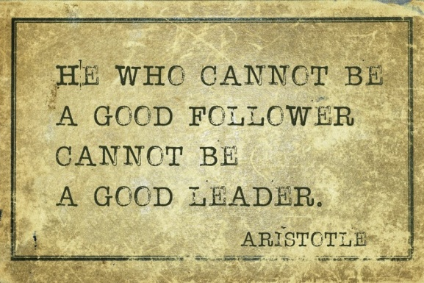
Leadership, Management & Team Building
What’s next?
Understand your personal talents, skills and traits and whether you are a more effective leader or manager?
What teams are you a part of and what is your role on each team? Build your team with people whose skill-sets complement your areas of weakness
- Expand this to include personal and professional teams, e.g., your family and your social groups
- Regardless of your role on the team, remember that effective leaders are also great followers
An effective (team) leader must:
  - be selfless
  - set the tone
  - be objective
  - focus on achieving results
Determine what you need to do in the next month to start to sharpen your skills and build an effective team. Respond to the growing leadership drought and expand your leadership, management and team building skills.
“It is not the most intellectual of the species that survives; it is not the strongest that survives; but the species that survives is the one that is able best to adapt and adjust to the changing environment in which it finds itself.” Charles Darwin
Notes:
This was meant to be an introduction and exposure to leadership, management and team building with the purpose of helping to guide you to understand your personal … {continue to review the bullets and end with the quote]

Slide 30
Back-up Slides

Slide 31
Other References
100 Answers to the Question: What Is Leadership? Lolly Daskal, President and CEO, Lead From Within http://www.inc.com/lolly-daskal/100-answers-to-the-question-what-is-leadership.html
Harvard Business Review - What Great Managers Do, Marcus Buckingham, March 2005.
Nanus, B. (1992). Visionary leadership: Creating a compelling sense of direction for your organization. San Francisco: Jossey-Bass.
The Complete Leader, Ron Price & Randy Lisk, Aloha Publishing, January, 2014.
Vision, Leadership, and Change Southwest Educational Development Laboratory (SEDL) merged with the American Institutes for Research (AIR) on January 1, 2015. This archived website contains the work of SEDL legacy projects and rich resources from the past 50 years. http://www.sedl.org/change/issues/issues23.html

Slide 32
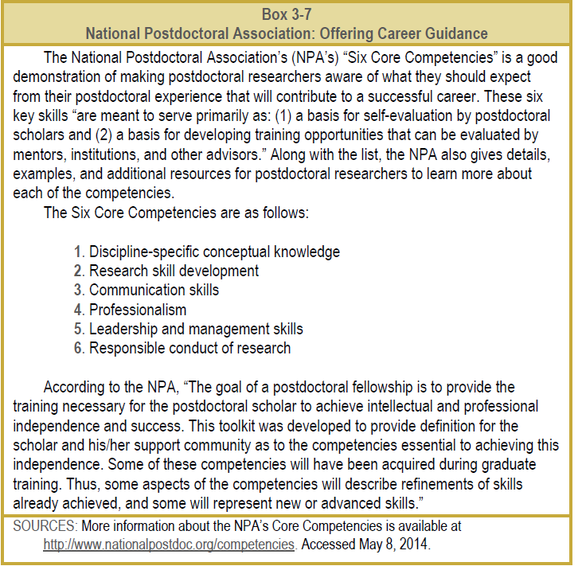
Core Competencies
Notes:
According to the National Postdoctoral Association, in addition to becoming a subject matter expert and achieving independence during a postdoctoral fellowship, six additional core competencies should be gained during this period, if they were not already exposed to or acquired during graduate training. The extent to which postdocs are exposed to and gain these competencies is dependent upon their fellowship experience.
In this short presentation, the aim is to expose participants to effective leadership styles, project management and team building skills.

